Slide 1
Product Recommendation System
Guide :Prof. Abha Marathe
Students Names :
Aditya Vaishale (64)
Suraj Chaudhari (66)
Aditya Ingale (77)
Khushi Junnare (80)
Mohish Khadse (84)

Slide 2
Introduction
What Are Recommendation Systems in Machine Learning?
Recommender systems are the systems that are designed to recommend things to the user based on many different factors. These systems predict the most likely product that the users are most likely to purchase and are of interest to

Slide 3
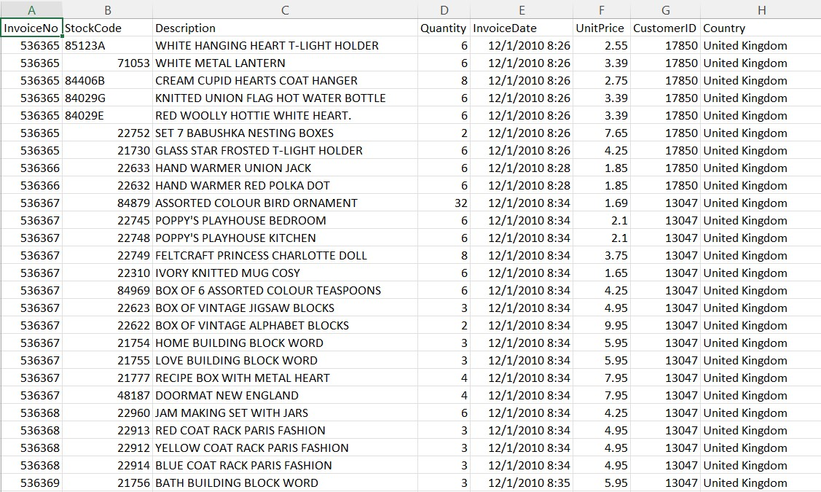
Data Set Description

Slide 4
Data Preprocessing
We used a dataset named as (OnlineRetail) for our project. We need to handle NA values in the CustomerID column to build a proper recommendation system. We need to build a customer-to-item matrix which is tabular data where each column represents each product, each row represents a customer, and values in each cell represent whether a customer purchased the given product or not. The customer-item matrix that was constructed in the previous step. It indicates if the buyer purchased the product (1) or not(0). Now we need to use the coop library to compute cosine similarity between customers.

Slide 5
Algorithms Implemented
Collaborative filtering is a technique that can filter out items that a user might like based on reactions by similar users. It works by searching a large group of people and finding a smaller set of users with tastes like a particular user.
User-Based Collaborative Filtering is a technique used to predict the items that a user might like based on ratings given to that item by the other users who have similar taste with that of the target user.
Item-item collaborative filtering is a type of recommendation system that is based on the similarity between items calculated using the rating users have given to items.

Slide 6
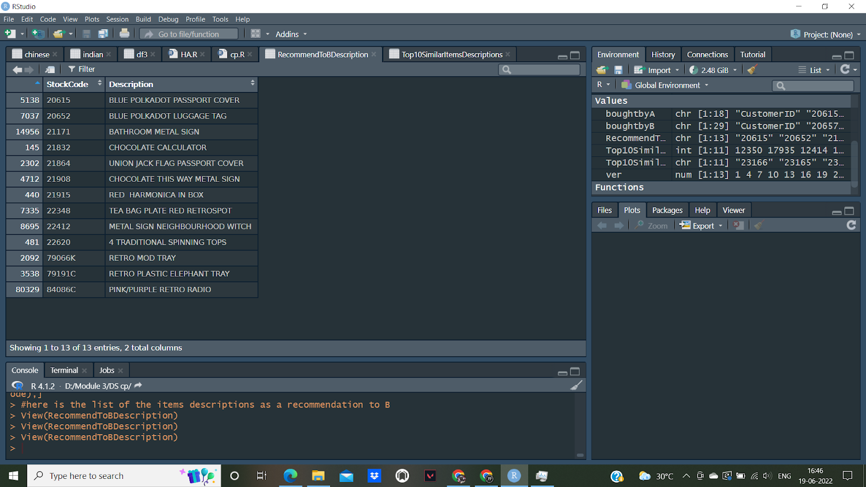
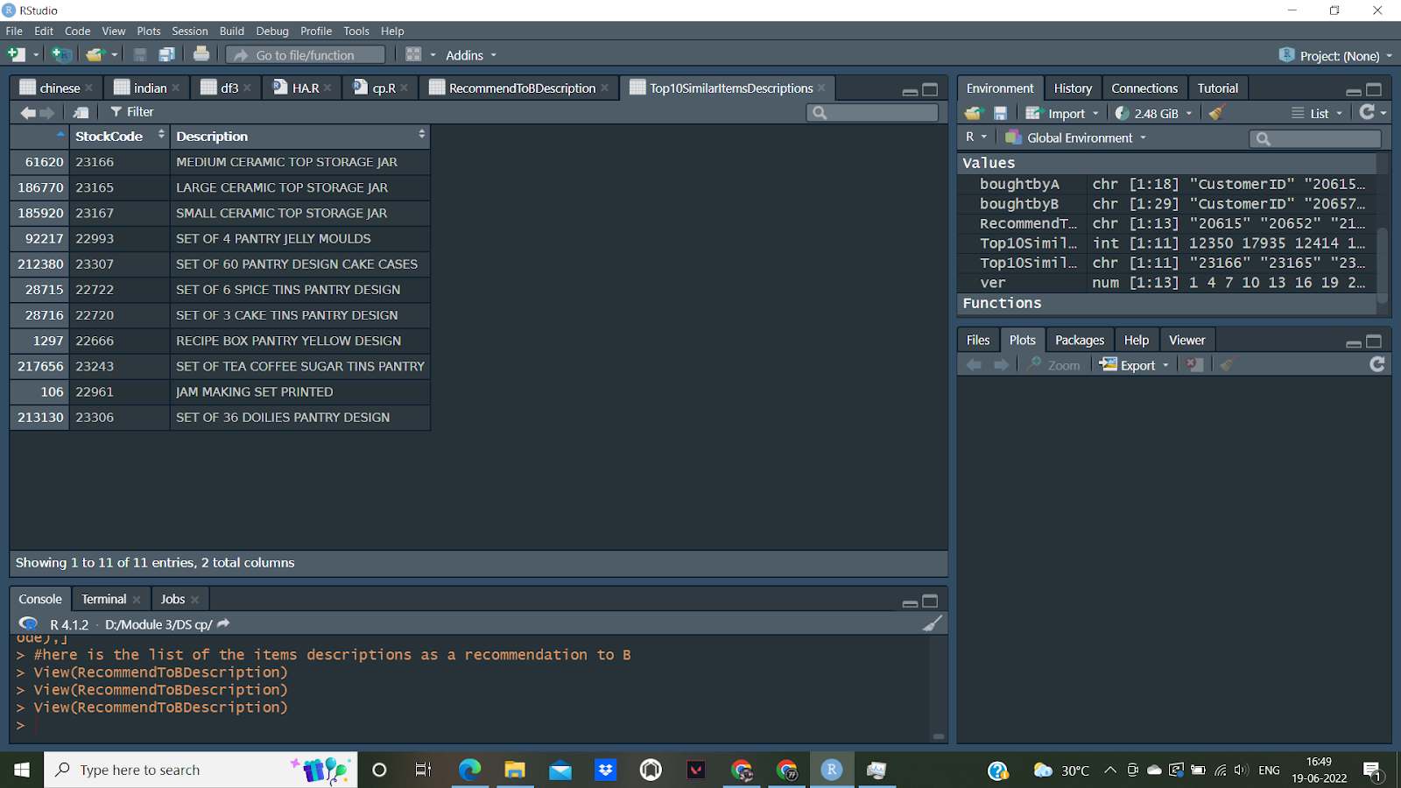
Results and Discussions
User Based Filtering
Item Based Filtering

Slide 7
Conclusion and Future Scope
By using Dataset, we learnt how to build a similarity matrix and how to propose new items in the Collaborative Filtering article.
By the help of 2 algorithms (user based Collaborative filtering and Item based Collaborative filtering) we successfully build our recommendation system on Dataset (OnlineRetail).
In conclusion, the study reveals that in all of the evaluated situations, user-based collaborative filtering is superior on datasets big enough to see practical application. Larger amounts of training data produce better outcomes, while the amount of testing data does not need to be very huge to produce a satisfactory result.

Slide 8
References
[1] A Case-Based Recommendation Approach for Market Basket Data Anna Gatzioura and Miquel Snchez-Marr IEEE INTELLIGENT SYSTEMS 2015.
[2] Recommender Systems: An overview of different approaches to recommendations.
Kunal Shah , Akshaykumar Salunke, Saurabh Dongare, Kisandas Antala
[3] Empirical Analysis of Predictive Algorithms for Collaborative Filtering.
John S. Breese, David Heckerman, Carl Kadie
[4] Collaborative Filtering via Gaussian Probabilistic Latent Semantic Analysis.
Thomas Hofmann
[5] kNN Versus SVM in the Collaborative Filtering Framework.
Miha Grˇcar, Blaˇz Fortuna, Dunja Mladeniˇc, and Marko Grobelnik
[6] Modeling Relationships at Multiple Scales to Improve Accuracy of Large Recommender Systems.
Robert M. Bell, Yehuda Koren and Chris Volinsky
[7] Comparison of User Based and Item Based Collaborative Filtering Recommendation Services
PETER BOSTRÖM and MELKER FILIPSSON

Slide 9
Thank You

